Slide 1



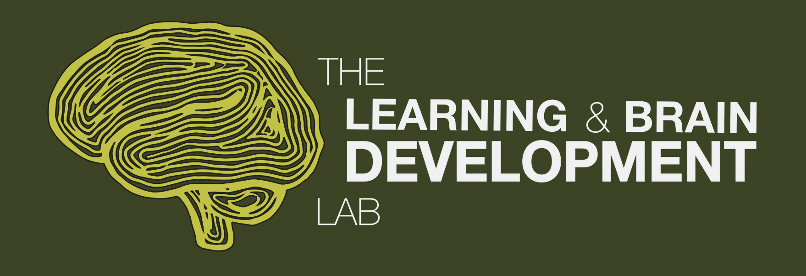
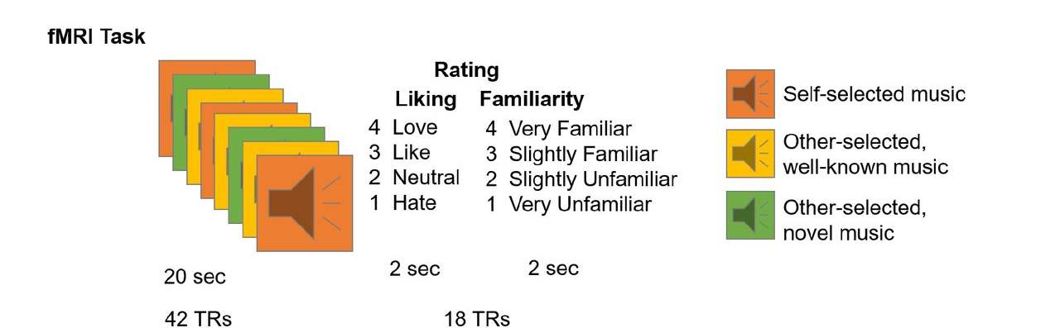
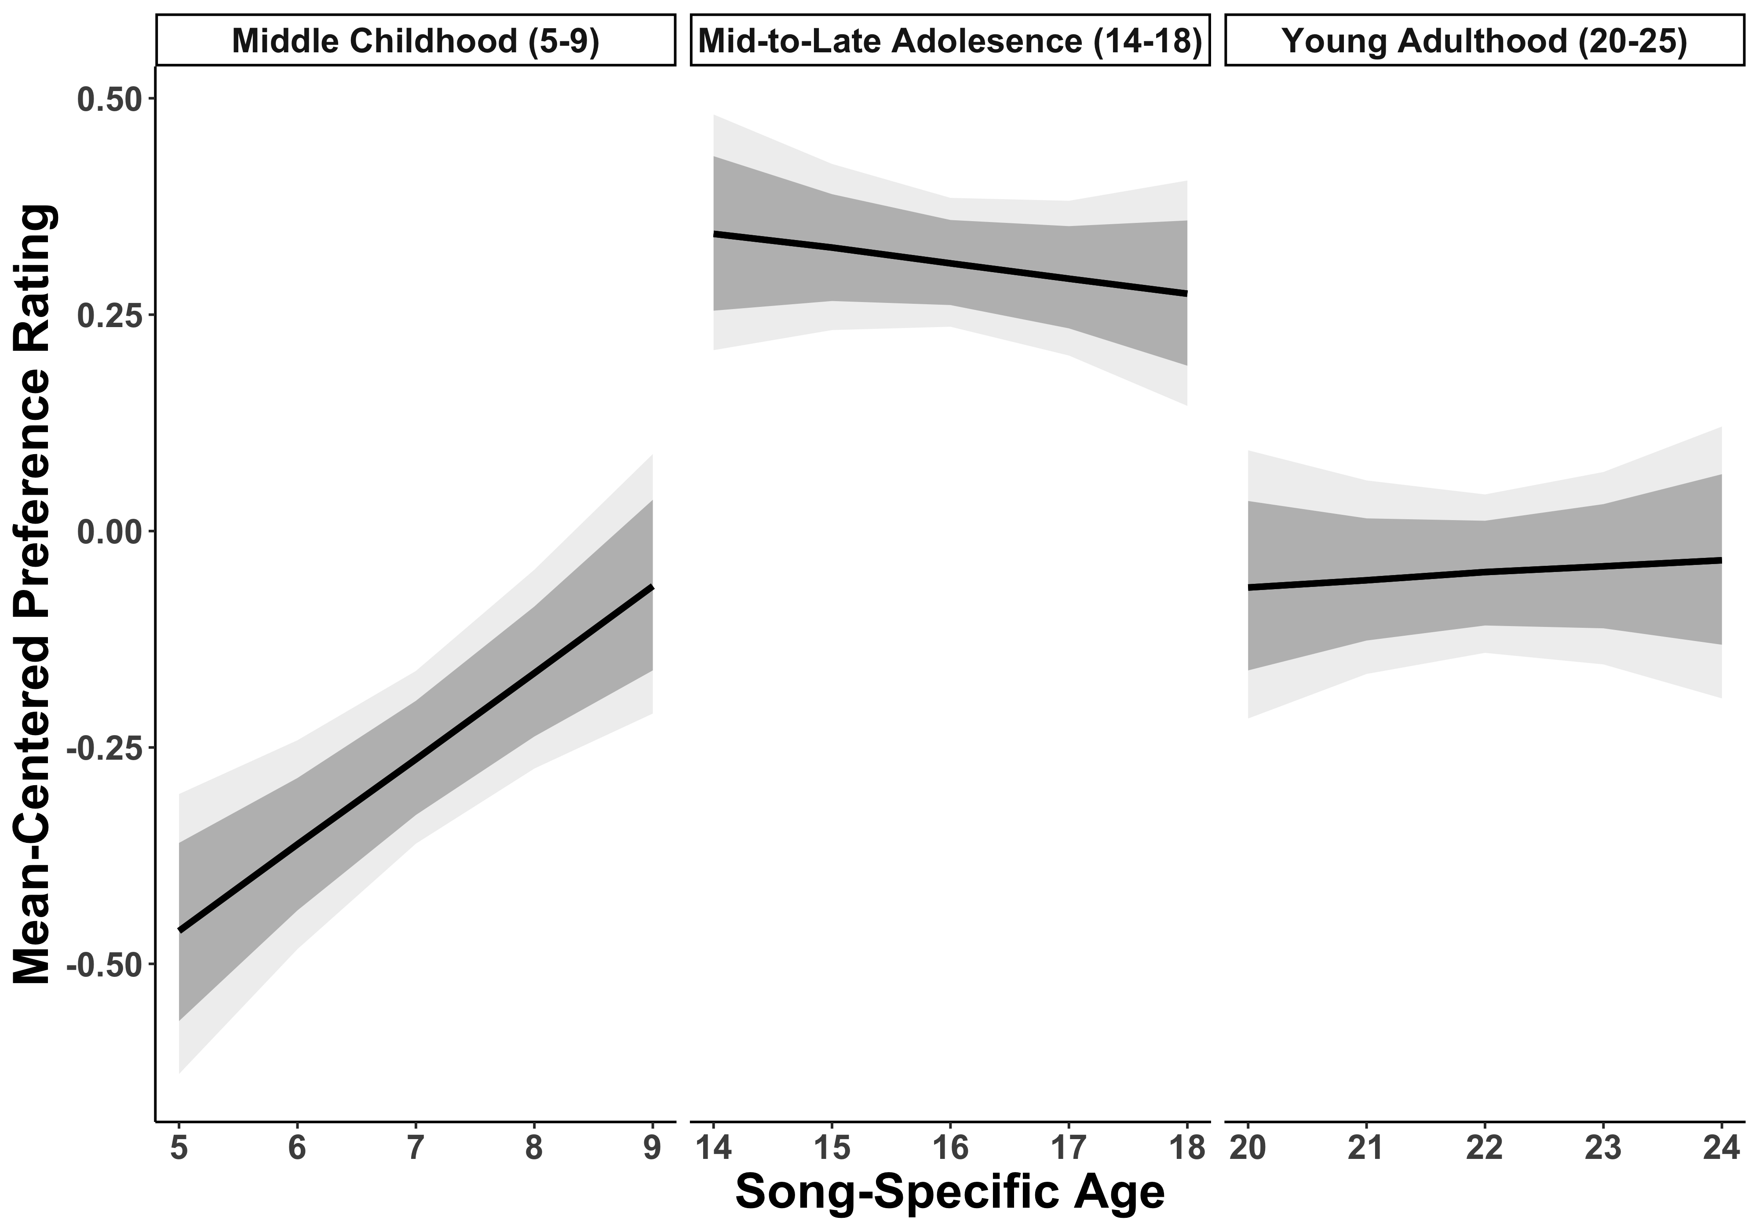
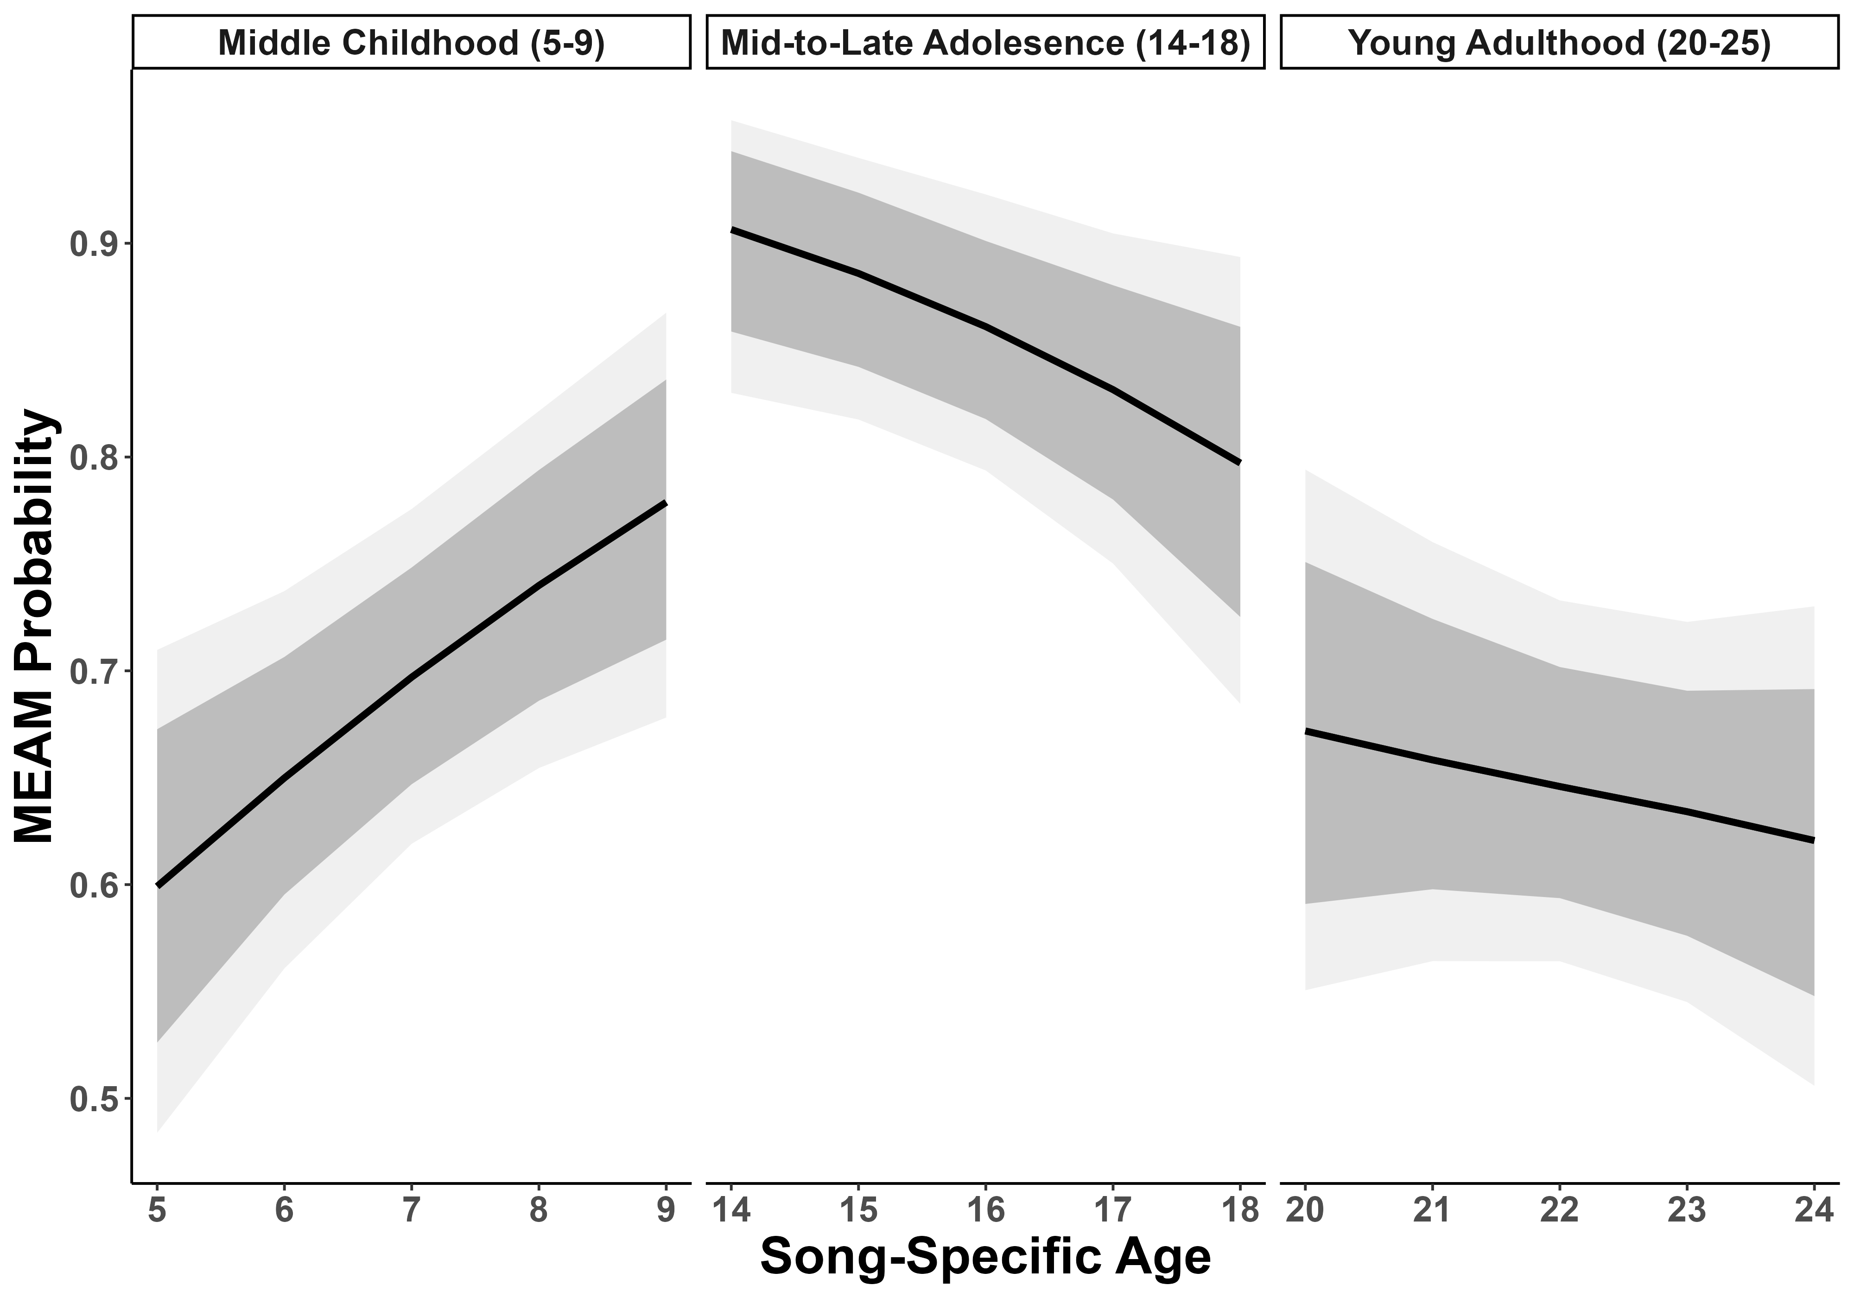
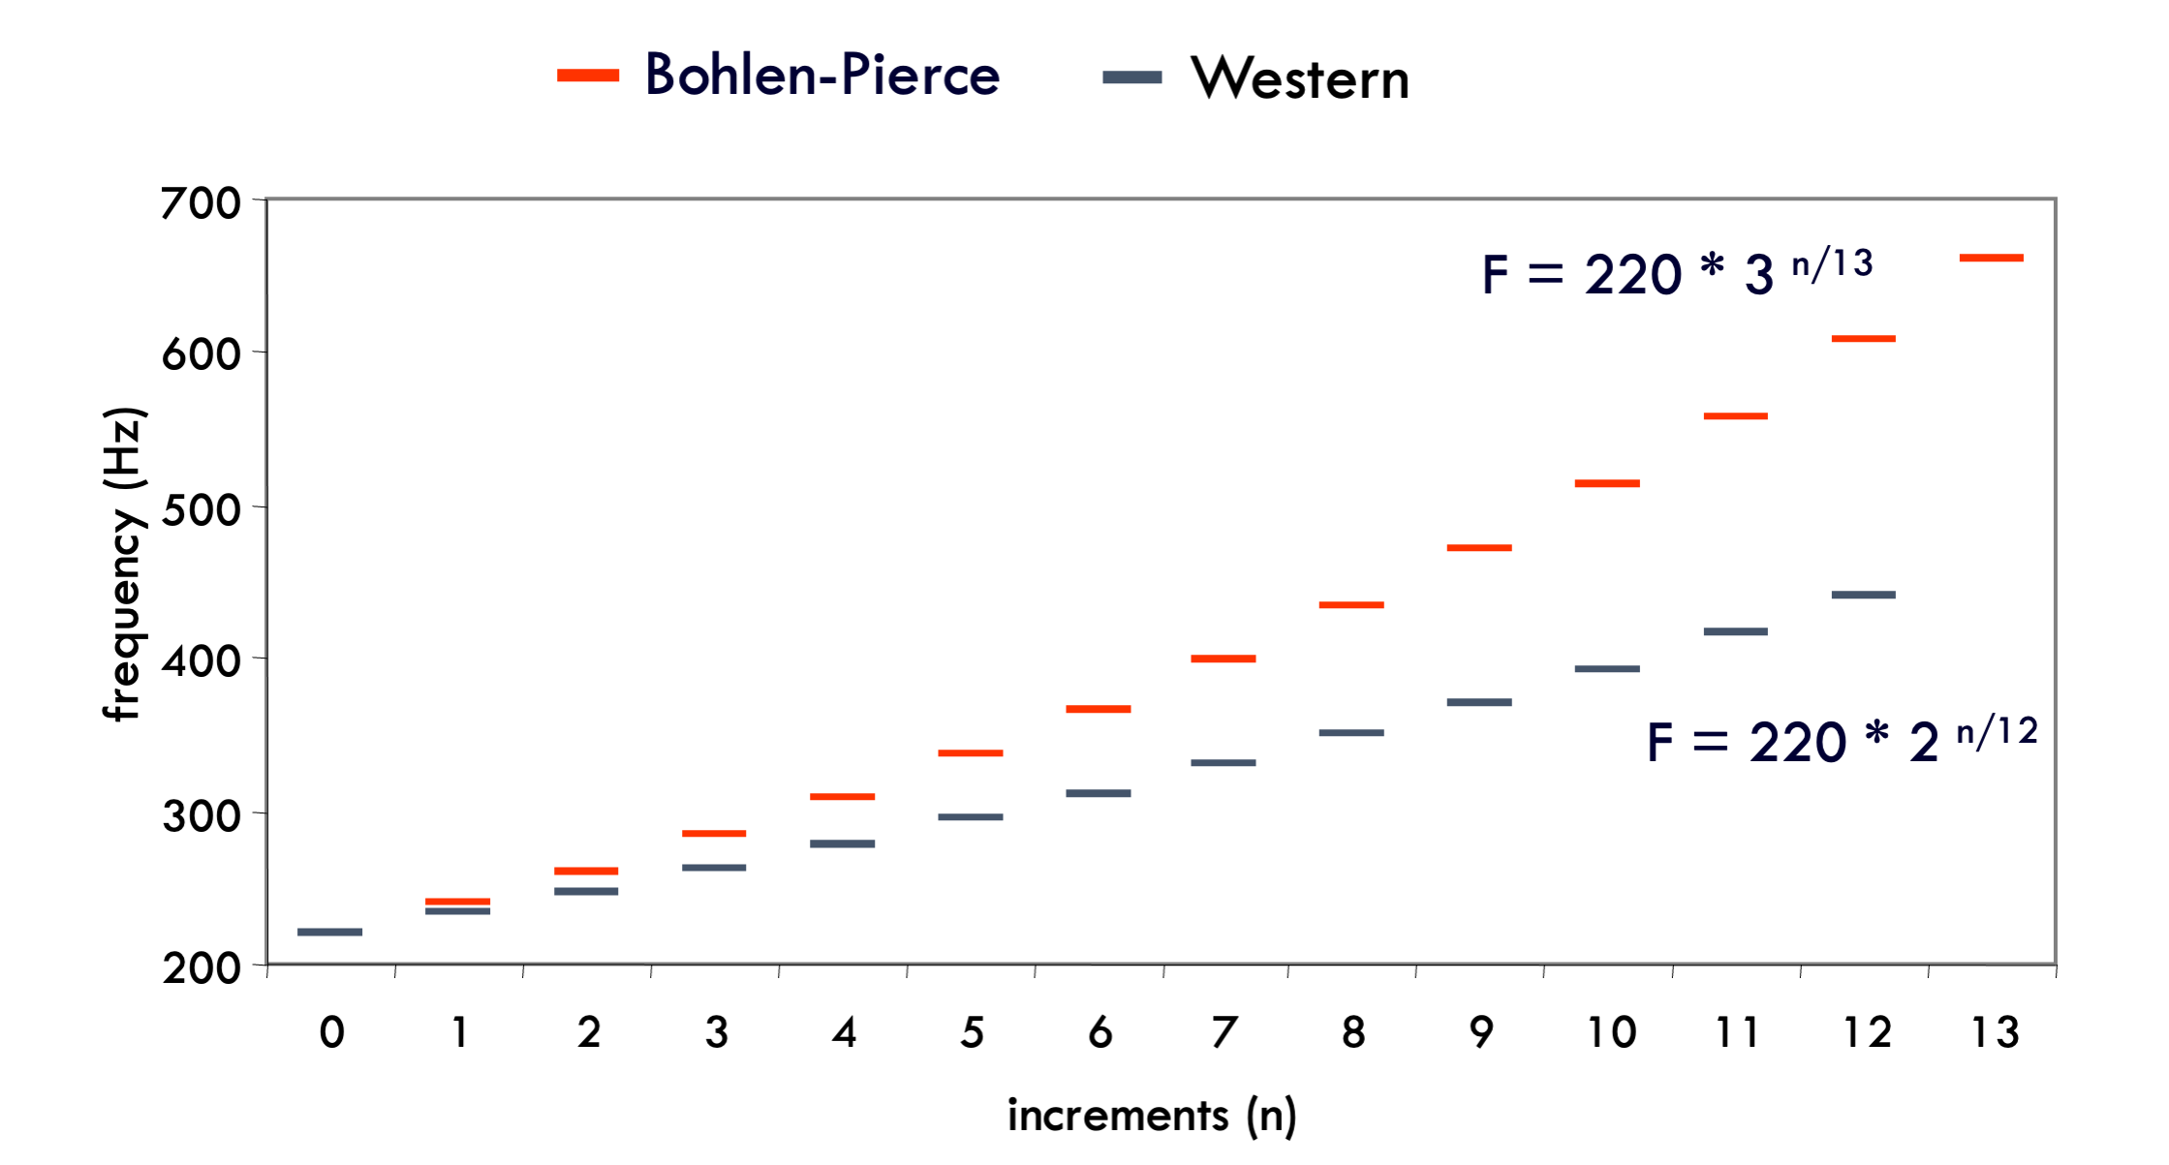

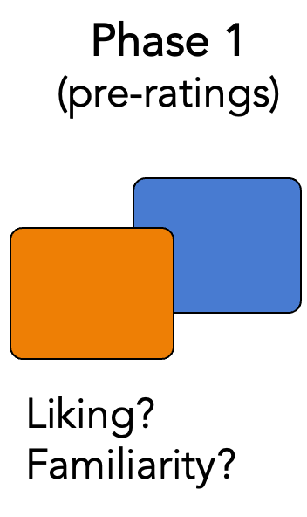
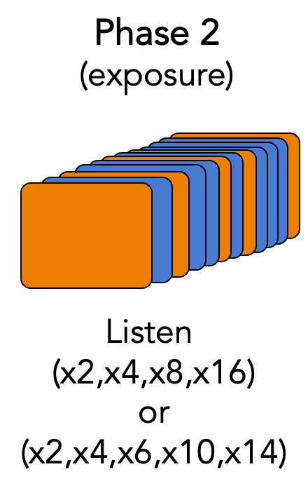
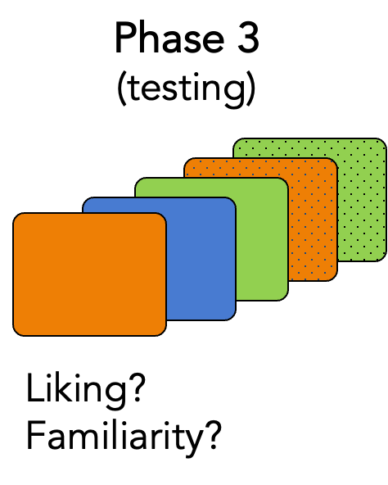
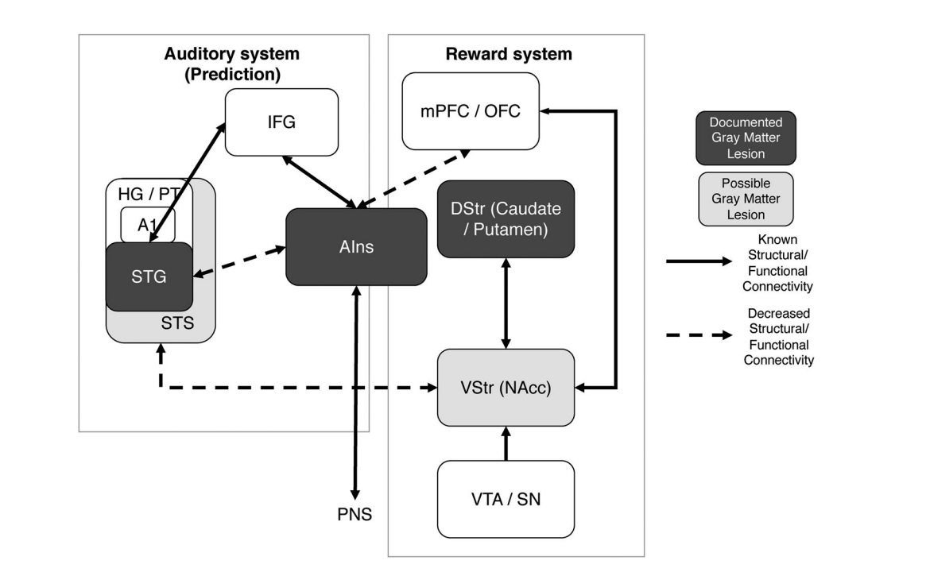
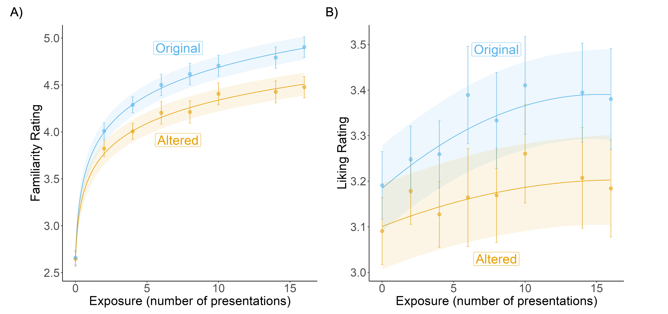
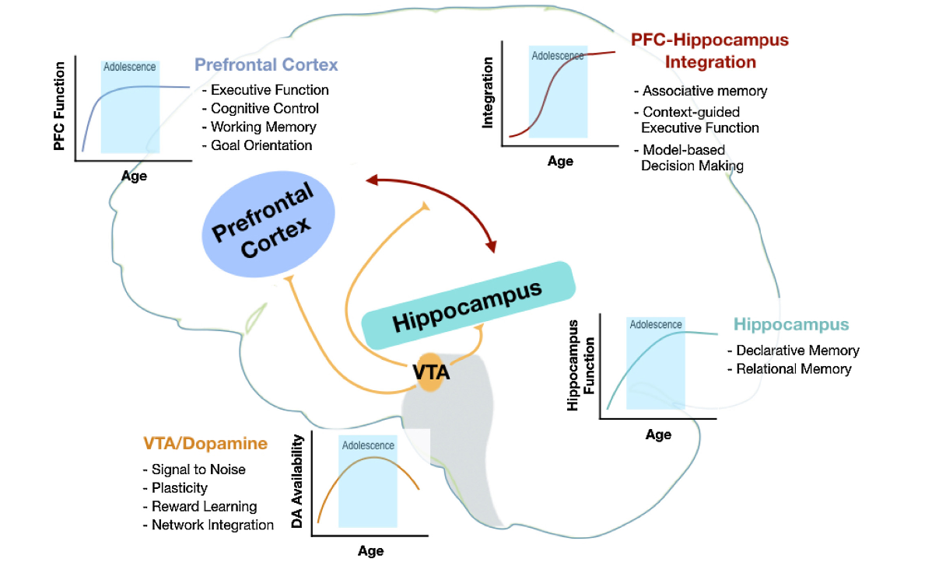
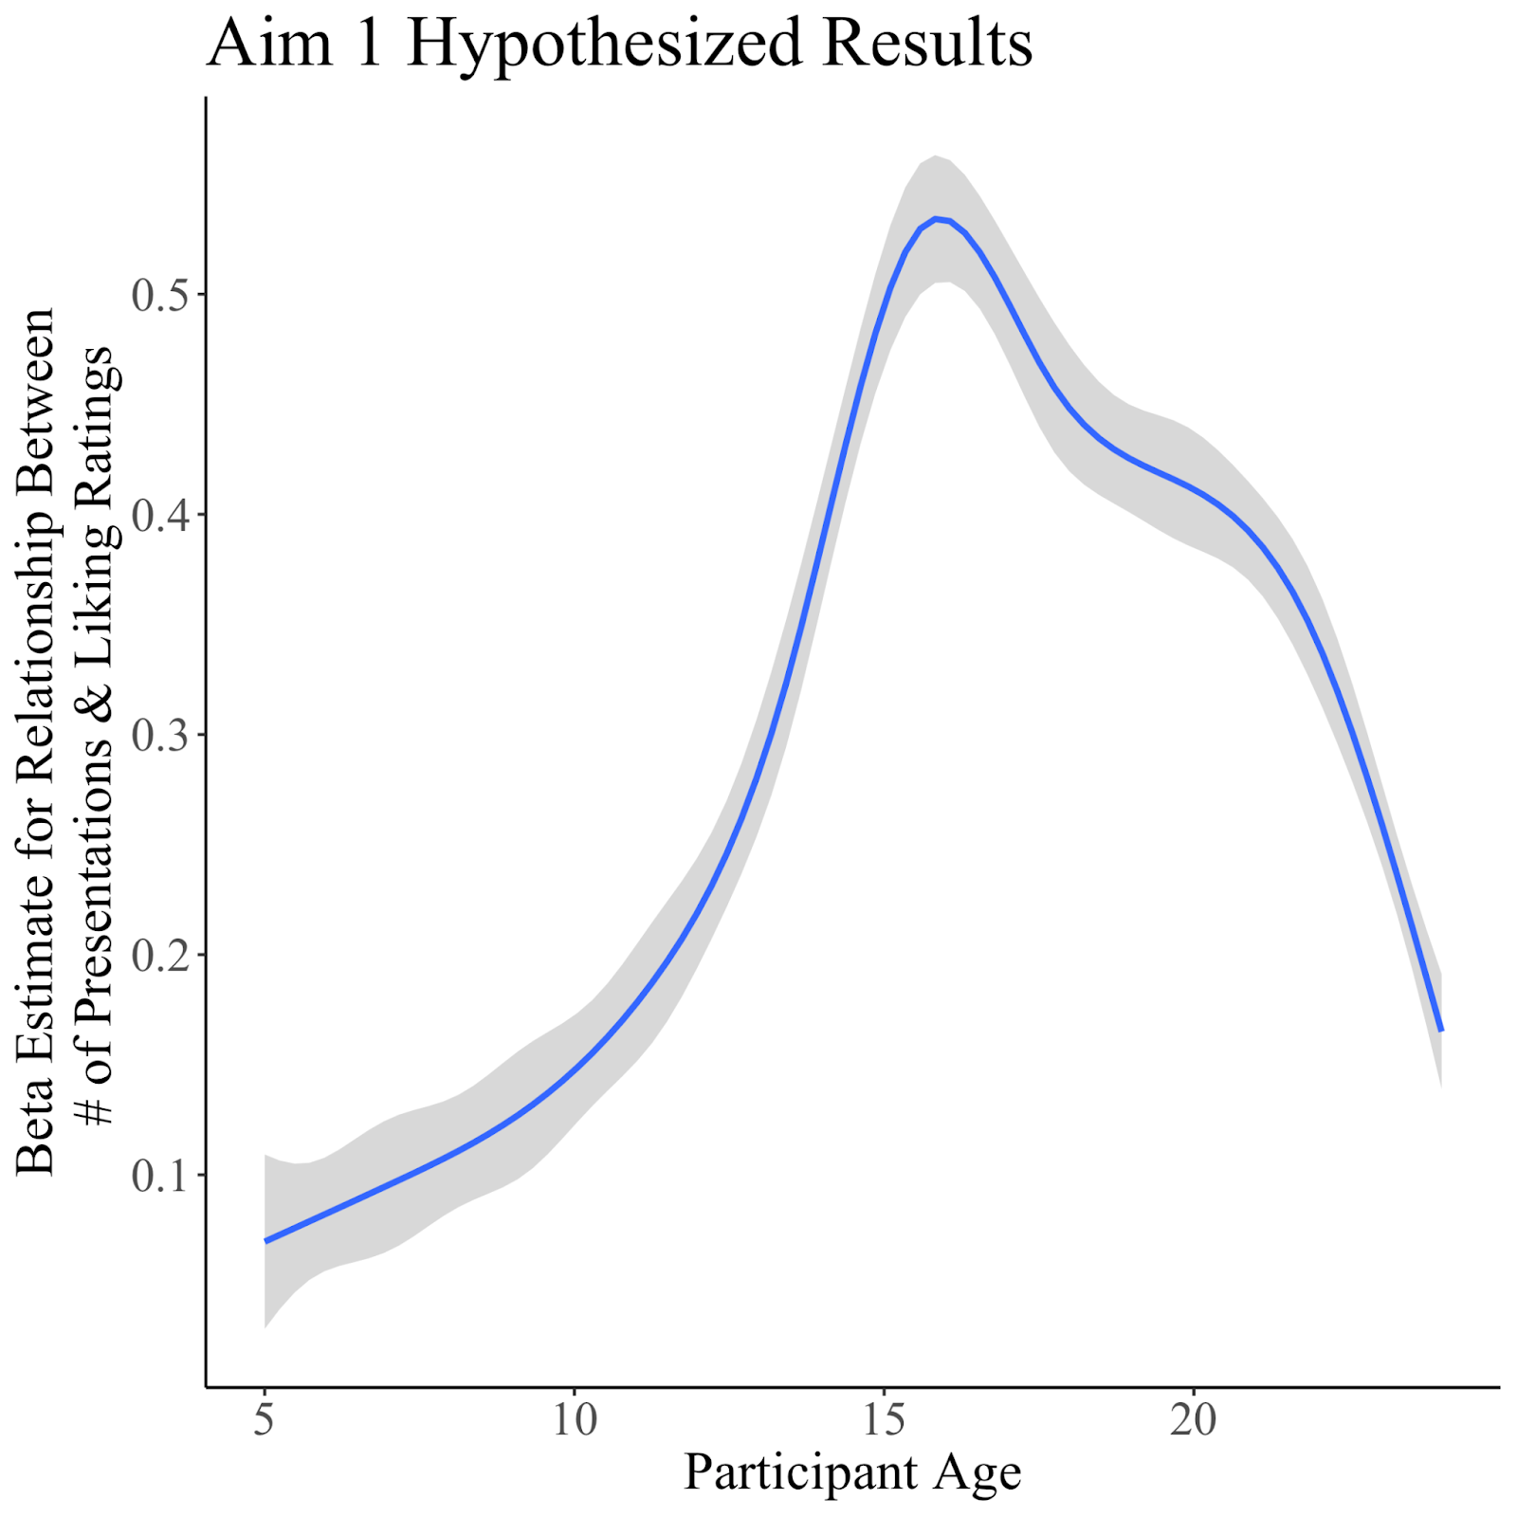




Leveraging novel music to examine age-related reward
responses across development
Nicholas Kathios, Kelsie L. Lopez, Juliet Y. Davidow, Laurel Gabard-Durnam, Psyche Loui
Northeastern University, Boston, MA
Introduction
Behavioral Task
Music Listening fMRI Task
Listening to music is regarded as one of the most pleasurable experiences across the lifespan (cite)
Older adults show lifelong preference for music from adolescence, which also elicits the most spontaneous music-evoked autobiographical memories (MEAMs) in this population (the “reminiscence bump” effect)
Music accrues implicit reward value by exploiting reward-prediction mechanisms4: listeners tend to prefer music with predictable acoustic and structural features.
Pleasurable music listening experiences involve interactions between the auditory and reward systems⁵
Adolescents show heightened sensitivity to reward-predictive cues5, attributed to different developmental trajectories between the subcortical reward system and frontal inhibitory functional development6
Using a novel behavioral (CITE) and music-listening (CITE) task, we propose testing the relationship between participants’ liking and familiarity of melodies they are exposed to with variable frequencies across a cross-sectional cohort of individuals ages 5-24,
Aim 1: Characterize differences in reward responses to music across children, adolescents, and young adults.
Aim 2: Use fMRI to examine functional connectivity differences during music listening across children, adolescents, and young adults
Listeners’ musical predictions are passively informed by past music exposure since birth
To ensure predictions are learned from statistical exposure in the task, music stimuli will be written in the Bohlen-Pierce scale, a musical system acoustically different from any existing scales across cultures:
BP Melodies from
Behavioral Task
Adult Data
Music Year of Release – Participant Year of Birth
Music Year of Release – Participant Year of Birth
Adult Data
Discussion
Research Question:
How do developmental changes in cognition and functional connectivity, particularly in adolescence, support age-related changes in music reward valuation across development?
Hypothesis: The age-related trajectory of the strength of the linear relationship between number of presentations and liking ratings will be best characterized by an inverse-U curve, peaking in adolescence. There will be no age-related differences in the strength of the relationship between familiarity and number of presentations.
Study Aims
References
kathios.n@northeastern.edu
lopez.ke@northeastern.edu
Study 1
Study 2

